Slide 1
Learning AwS
A Cloud Guru Training Sessions

Slide 2
Miscellaneous notes
AWS US East (N. Virginia)
This region is the oldest and it is where most of the new services are deployed first for consumption by the public
is a region that tends to go down at least once a year.
AWS Support Levels
Basic plan
Developer plan
Business plan

Slide 3
AWS Global Infrastructure (2019)
Region
A geographical area that may contain 2 or more availability zones
24 regions globally
Availability zone
An AZ is a facility similar to a data center
Have computers, SAN, redundant power, redundant backbone to internet.
Facilities which are close together are counted as being in the same availability zone
72 availability zones globally
Edge Location
These are endpoints for AWS which are used for caching content. Examples are
AWS cloudfront which is Amazon’s CDN
There are over150 Edge Locations globally

Slide 4
Core AWS services for Architect cert
AWS global infrastructure
Region > Availability Zone > Edge Logcation
Compute
EC2, LAMBDA
Storage
EFS, S3
Databases
RDS, Dynamo
Network & Content Delivery
Knowing this area inside-out is key to passing the exam
Know VPC & Route 53
Cloudfront (amazon’s CDN)
Security, Identity & Compliance
Knowing this area inside-out is key to passing the exam
Know IAM very well

Slide 5
IAM 101 with AWS
Centralized control of your AWS account
Shared access to your AWS account
Granular permissions
Identity federation (AD, FB, LinkedIn, etc.)
MFA
Provide temporary access for users/devices and services where necessary
Allows setup of password rotation policies
Integrates with many different AWS services
Supports PCI DSS compliance
IAM is the most important service in AWS because it controls access to all other AWS services.
Power User Access – allows access to all AWS services except the management of Groups and Users within IAM
Read this white paper: https://aws.amazon.com/whitepapers/

Slide 6
AWS IAM – Key Terminology
Users
Represents end users (i.e. people in an org)
Accounts for individual users
Can have permissions assigned to them
Groups
Can have permissions assigned to them
Users can be members of a group
Users who are members of a group will inherit the permissions of said group
Roles
Are assigned to AWS resources
Policies
JSON documents that describe permissions that a User/Group/Role is able to do

Slide 7
IAM – Key concepts
IMPORTANT:
Activate MFA on the root account. Keep your root account QR code in a secure location to be able to reactivate in case you lose your phone.
Operations on IAM are global. We cannot create a user for a specific region or availability zone.
You can create users of 2 types
Programmatic Access – to access AWS services programmatically (for Devs)
Console Access – to access AWS web-based console to manage your AWS account settings
Users – Represent the users of AWS services. They can be granted actions to resources (not recommended)
Groups – contain users and are governed by Policies
Policy – determines what ACTIONS can be taken on what RESOURCES
Roles – Determines a secure way to grant permissions to entities we trust

Slide 8
IAM – Create a billing alarm
A billing alarm helps keep watch over an AWS account.
CloudWatch – it is the AWS service that can be used to create billing alarms
SNS Topic – it is an AWS service called “Simple Notification Service” (SNS) that allows services to send messages to other services.

Slide 9
AWS Service – S3
S3 – Simple Storage Service
S3 allows you to create folders (AWS calls them Buckets) where you can store objects (files)
Files can have 0 bytes to 5 Terabytes
By default, an account can have 100 buckets
Buckets have a globally unique web address
Uploading Large Objects: https://docs.aws.amazon.com/AmazonS3/latest/dev/UploadingObjects.html
When uploading files to a bucket location you, if it was successful, you will get an HTTP 200 response code.
Each object (file) has certain attributes
Key – the name of the file. It must be unique within a bucket
Value – the content of the file (bytes)
Version – the version of the file. Important when you are uploading objects with the same key to the bucket location.
Metadata – additional data about the S3 object that is stored in a bucket
Subresources
Access Control Lists
Torrents

Slide 10
AWS Service – s3
Data Consistency
Read after Write consistency for 1st PUT of a new objects
Eventual Consistency for overwrite PUTs and DELETEs for existing object (can take some time to propagate)
S3 guarantees
Built for 99.99% availability – 52.6 seconds in a year of downtime
Amazon guarantees 99.9% - 8.76 hours in a year of downtime
Amazon guarantees 99.999999999% of Durability –
Features
Tiered storage
Lifecycle management
Versioning
Encryption at rest
MFA Delete
Security with ACL and Bucket Policies

Slide 11
Aws services – s3
Storage Classes (Tiers)
S3 standard
99.99% availability
99.999999999% durability (11 x 9’s)
Stored redundantly across multiple devices in multiple facilities
Designed to sustain the loss of 2 facilities concurrently
S3 Infrequent Access (IA) – Cheaper than S3 Standard but data retrieval fees apply
Availabilty ??
S3 One Zone IA – lower cost option when IA applies but data resiliency is not require
Availability is 99.50%
S3 Intelligent Tier – Designed to optimize storage costs by automatically moving data to the most cost effective tier without performance impact or operational overhead
S3 Glacier – Cheaper option than previous. Competitive with on-prem data storage. Retrieval times are configurable from minutes to hours.
S3 Glacier Deep Archive – Lowest cost storage class for file storage cases where a retrieval time of 12 hours is acceptable.
Read through the S3 FAQ’s before taking the exam

Slide 12
S3 – Encryption for buckets
By default newly created buckets are private
Access Control can be set for a bucket with
Bucket Policies
Access Control Lists
S3 buckets can log access to it
Logs can be sent to another bucket on the same account
Logs can be sent to a bucket owned by another account
Buckets can be Encrypted
In transit – use HTTPS with ssl/tsl
At rest – encrypting data that is stored
Server side – AWS encrypts the object when it is stored
S3 managed keys – AWS manages the encryption keys for you with server side encryption (SSE-S3)
AWS key management service – you and AWS manage the encryption keys (SSE-KMS)
Customer provided the Keys (SSE-C)
Client side – you encrypt the object before you upload it to AWS S3 bucket

Slide 13
S3 - versioning
Stores all versions of an object including writes and even deletes
Removing a delete marker will re-enable the file that was deleted. It is like a soft delete.
Can be used as a backup tool
Once enabled it cannot be removed from the bucket. It can only be suspended. If you need to remove you’ll need to
Integrates with LifeCycle rules
Can activate MFA deletion for an additional layer of security

Slide 14
S3 – lifecycle management
Automates moving objects between the different storage tiers
Can be used in conjunction with versioning (versioning does not have to be turned on to use lifecycle management)
Can be applied to current versions or previous versions

Slide 15
S3 – cross-region replication
Versioning must be enabled in both the source and destination buckets
Regions have to be unique when using cross-region replication.
Same-Region replication is possible (as of recent in 2019?) to a bucket in the same region – bucket names have to be unique.
Files in an existing bucket are not replicated automatically. Only files that are added to a bucket after crr is turned on are replicated.
All subsequent updated files will be replicated automatically
Delete markers are not replicated
Deleting individual versions are not replicated

Slide 16
S3 – transfer acceleration
Uses the CloudFront Edge Network to speed up your uploads to S3 buckets
You can upload to CFE location which then it will transfer to an S3 bucket
Use the testing tool to measure times and figure out better Edge Locations to use for your application
http://s3-accelerate-speedtest.s3-accelerate.amazonaws.com/en/accelerate-speed-comparsion.html

Slide 17
AWS Cloudfront
Edge Location: An AWS network location where content is cached. This is physically separate from a AWS Region or AWS Availability Zone (AZ)
Origin: is the location where the original content resides. It can be an S3 bucket, an EC2 instance, and ELB or Route 53.
Distribution: is the name given to a CDN which is a collection of Edge Locations
Types of CF
Web Distribution – used for websites
RTMP – Used for media streaming. RTMP is Adobe’s Real-Time Messaging Protocol
Edge Locations are not just read-only. You can write to them too.
Objects are cached at an Edge Location based on a Time-To-Live (TTL) value
You can clear (invalidate) cached objects before their TTL value. However, you will be charged extra for that action

Slide 18
AWS – Cloudfront lab
CloudFront is a GLOBAL service
Access to Cached Content can be restricted to signed urls/cookies
To activate, you need to create/define a Cloudfront Distribution
This is not covered by AWS’ Free Tier – you will incur in some costs
To delete a Cloudfront Distribution you need to first mark it as “disabled” then it can be deleted

Slide 19
Snowball
It is a service to help move massive amounts of data
from on-prem to AWS
From AWS to on-prem
Need to issue a request. AWS sends you a device that you need to activate and connect to your local network
SNOWBALL - It is secure, full chain of custody, 256 bit encryption. Can transfer 50tb or 80tb. AWS performs erasure
SNOWBALL EDGE – 100tb. It is like having a mini-aws at your disposal. It can be clustered with other SE.
SNOWMOBILE – 100pb. It is a truck that has serveral snowball edges networked
Used snowball when you have
44 Mbit/s to internet and you need to transfer more than 2tb of data
100 Mbit/s to internet and you need to transfer more than 5tb of data
1000 Mbit/s to internet and you need to transfer more than 60tb of data

Slide 20
Aws – storage gateway
Used to move data into AWS. It is a service that connects on-prem software appliance to AWS cloud
It can be a virtual (download a VM image) or physical device
Options
File Gateway – files are stored as objects on s3 buckets
Ideal for existing operations with large bodies of documents
Volume Gateway – iSCSI block protocol - copies of data in HD for
stored volumes – all data on the HD will be copied/backed-up to an s3 bucket
cached volumes – let’s you use s3 as your primary data storage while retaining frequently used data on-prem storage infrastructure
Tape Gateway – a virtual tape library
Allows to leverage your existing tape infra and moving your backups to cloud
Used for archival purposes
You can use Glacier service to reduce costs of archival of infrequently used data

Slide 21
EC2 - 101
Elastic Compute Cloud
Is a web service for resizable compute in the cloud
Reduces the time it takes to obtain and reboot servers
Allows for quick scaling (up/down) of compute requirements
Virtual Machines in the cloud
Run on Xen and Nitro Hypervisor software
Pricing
Pay as you go
Pay for what you use
Pay less as you use more even as capacity is reserved
Tiers:
Reserved – capacity reservation for 1 yr or 3 yr
On-demand
Dedicated Host – exclusive for an account
Spot – bid your price for available capacity at lower rate

Slide 22
EC2 Tier – On Demand
Pay a fixed rate
Pricing is by the hour or by the second
No commitments

Slide 23
EC2 Tier – Reserved instances
Contracts for 1 yr or 3 yr with deeply discounted prices from the on-demand tier
Standard Reserved Instances
Up to 75% discount.
The more you pay upfront or the longer the contract the more you save
Once the contract starts you cannot change the computing choices you make
Convertible Reserved Instances
Up to 45% discount
Allows you to change the computing choices within the contract to equal or greater value
Scheduled Reserved Instances
These instances allow you to use compute capacity during a specific time window (fraction of day, week, a month)

Slide 24
EC2 Tier – Spot & Dedicated host Pricing
Spot
Price moves up/down depending on Amazon’s demand and available capacity
Designed for apps that have flexible start/stop lifecycle
Ideal for Apps that are only feasible at very low compute prices
Accommodates urgent computing needs and large amount of additional capacity
If the system terminates your work load you will not be charged for fraction of hour. If you terminate the instance, you will be charged for whatever fractions you used.
Dedicated Host
When regulation does not allow for sharing compute environment (i.e multitenant virtualization)
When software licensing does not allow multitenant virtualization

Slide 25
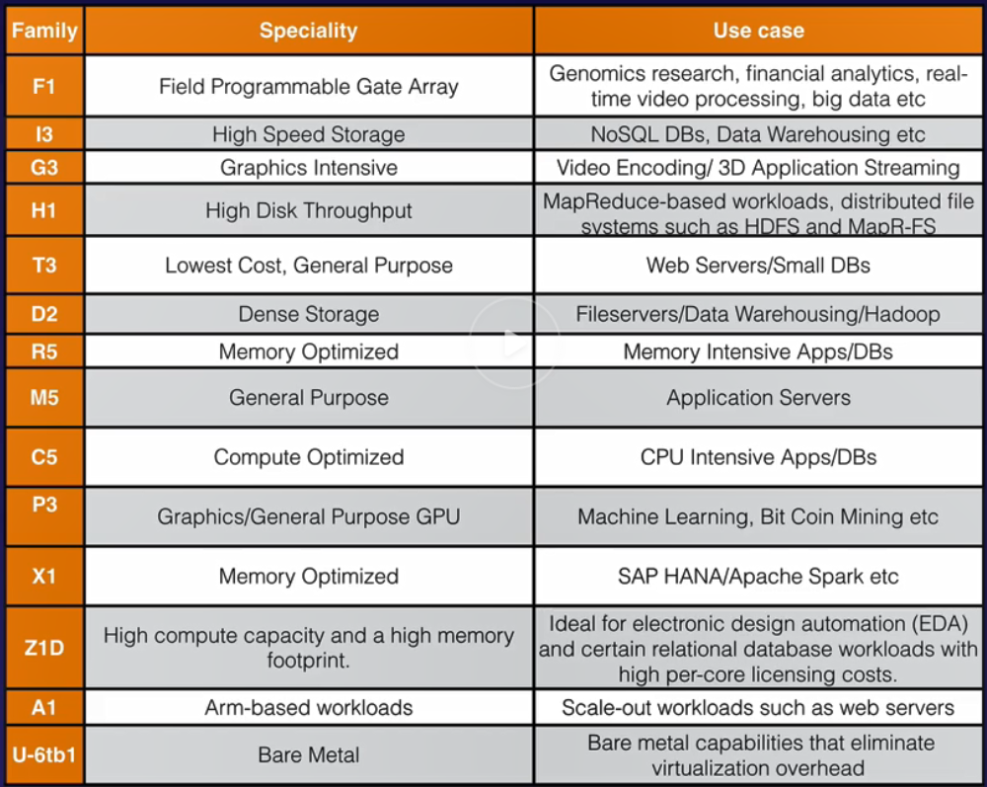

EC2 instance types
F - FPGA
I - IOps
G - Graphics
H – High Disk I/O
T – Cheap T2 Micro
D – dense storage
R - Ram
M- Main choice (gen)
C - Compute
P – proc Pix/bit coin
X – eXtreme memory
Z – eXtreme Mem & Cpu
A – ARM based loads
U – Bare metal

Slide 26
EC2 – Lab Notes
EXAM TIPS:
Termination Protection is turned “ON” by default
On EBS-backed instance, the default action is for the root EBS volume to be deleted when instance is terminated
EBS root volumes can now be encrypted
You can encrypt root volumes with 3rd party tools like bitlocker
You can add more volumes and encrypt those as well
Creating a simple Linux / Apache HTTP service
Spin up an EC2 instance
Select a type (eligible for free tier)
Take all defaults
Storage
You can add additional storage space by adding volumes (on top of OS requirements)
Root device volumes can be encrypted (it was not always the case)
Termination Protection
Tick the box for warning for accidental termination. It is turned off by default
Provide some tag attributes
Generate keys pair (pub/private)
Ssh to the new instance with IP address (user is ec2-user)
Do “sudo su” to be root
Install apache httpd service
Setup a basic index.html file
Turn on httpd service
Voila!

Slide 27
SECURITY GROUPS
All in-bound traffic is blocked by default
All out-bound traffic is allowed
Changes to security groups take place immediately
You can have any number of EC2 instances in a security group
You can have multiple security groups attached to an EC2 instance
Sec Groups are stateful
When opening ports, it opens for both in-bound and out-bound traffic
Network ACL are stateless
When opening ports, you have to specifically declare the in-bound and out-bound rules
If you create a rule allowing traffic in, automatically there will be a rule created that allows traffic back out
IP addresses cannot be specifically blocked with security groups
Network ACL’s allow you to define blocked IP addresses

Slide 28
EBS 101 – Elastic block store
Provides persistent block storage volumes for use with EC2 instances
Think of it as Hard Drive in the cloud for a given virtual machine
This service is based on Block Storage (EFS and FSx are also based on Block Storage)
Read this to learn about optimizing EBS volume performance
Each EBS is automatically replicated within it’s AZ to increase performance. This done to reduce latency between the virtual mother-board and the virtual HDD
Durability
Availability
Prevent single point of failure
There is a restriction of 50:1 ratio between IOPS and Volume Size
There are 5 types of EBS
General purpose SSD
Provisioned IOPS SSD
Throughput Optimized HDD
Cold HDD
EBS Magnetic

Slide 29
Elastic Block Storage – Types
G.P. T.E.C.
Solid State Drives (SSD)
General purpose SSD
Use Case: Most workloads
Balances prices v performance
Size: 1GB – 16TB
Max IOPS 16,000
API name gp2
Provisioned IOPS SSD
Use Case: Databases
Highest performance for mission critical cases
Size: 4GB – 16TB
Max IOPS 64,000
API name io1
Hard Disk Drives (Magnetic)
Throughput Optimized HDD
Use Case: Big Data/datawarehouse
Low cost freq. access high throughput workloads
API Name: st1
Size: 500 GB – 16 TB
Max IOPS: 500
EBS Magnetic
Use Case: infrequently accessed data and you are not using GLACIER
Previous Generation HDD
API Name: Standard
Size: 1 GB – 1 TB
Max IOPS: 40 – 200
Cold HDD
Use case: File Servers
Lowest Cost HDD. Less frequently accessed workloads
API Name: sc1
Size: 500 GB – 16 TB
Max IOPS: 250

Slide 30
Elastic Block Store – Exam Tips
Volumes exist on EBS. EBS can be thought of as virtual HDD attached to a VM
Creating an EC2 instance will automatically create a root volume
Snapshots (a “picture” of a volume) are stored in s3
Snapshots are a point-in-time copy of a volume
Snapshots are incremental. Subsequent “pictures” of the same volume will only copy DIFF blocks between the original picture and the subsequent pictures.
The first snapshot takes the longest to create.
In a production case, you should stop the EC2 instance before creating a snapshot. This will ensure that the snapshot is pristine.
Snapshots can be created on a running instance.
You can create an AMI (Amazon Machine Image) from either volumes or snapshots
Volume sizes and type can be changed on the fly. You may need to access the specific OS to ensure that the added volumes are visible to the OS.
aev - You cannot decrease the size of a volume, only increase.
EBS Volumes will ALWAYS be on the same AZ as the EC2 instance that owns them
To move an EC2 instance from one AZ to another, you need to first create a SNAPSHOT of it’s Root volume, then create an AMI off of it and then use AMI to launch the EC2 instance in another AZ.
To move an EC2 instance from one region to another, you need to snapshot > AMI and copy the AMI to the desired region. Then you can launch the EC2 instance in the desired Region/AZ.
You can perform actions on snapshots with AWS API, CLI or AWS Console

Slide 31
AMI Types – EBS VS instance store
Differences between EBS and Instance Store
All AMI’s are categorized by the type of backing of the volume of the root device (where the OS is installed)
EBS - backed
The root device is a volume created from an EBS snapshot
It persists through time after the EC2 instance is stopped
If the Hypervisor running an EBS-backed VM stops working you can simply re-start it
Instance Store – backed
The root device is a volume created from a template stored in Amazon S3
IS-backed EC2 instances can only be rebooted or terminated. Cannot be stopped
If the Hypervisor running an IS-backed VM crashes you will lose all of your data/info on that instance
S. O. L. A. R. AMI
Selection of AMI can be based on
Storage of the root device volume type
EBS backed volumes
Instance Store, also known as Ephemeral (temporary) Storage
Operating System
Launch Permissions
Architecture (32 bit or 64 bit)
Region or AZ

Slide 32
Encrypted root device Volumes and snapshots
Snapshots of encrypted volumes are encrypted automatically
Volumes restored from encrypted snapshots are encrypted automatically
You can share snapshots only if they are unencrypted
Snapshots can be shared with other AWS accounts or made public
You can now encrypt volumes upon creation of the EC2 instance
To encrypt a volume after it has been created:
Create a snapshot of the unencrypted volume
Create a copy of the snapshot and select an encryption option
Create an AMI from the encrypted snapshot
Launch new EC2 instance off of the encrypted AMI

Slide 33
Cloudwatch 101
Monitors Virtual things like:
Compute
EC2 instances
Autoscaling groups
Elastic Load Balancers
Route53 Healthchecks
Storage & Content Delivery
EBS Volumes
Storage Gateways
Cloudfront
Monitors Host-level events like:
CPU
Network
Disk
Status check
System – Underlying hypervisor (physical computer)
Instance – EC2 instance (VM)
Exam Tips:
Cloudwatch is used for monitoring performance
It monitors most of AWS infra as well as VMs and Apps running on AWS infra
Cloudwatch with EC2 will monitor events every 5 minutes
With detailed monitoring you can evaluate in 1 minute intervals
You can create Cloudwatch alarms that can trigger notifications
Cloudwatch is about performance (how are the HOST Machine and VM machine operating).
Do not confuse with Cloudtrail, which monitors auditing (who is doing what on which resource)
You can create dashboards to visualize:
Alarms – to notify of thresholds are hit
Events – to respond to state changes in AWS resources
Logs – aggregate, monitor and store logs

Slide 34
AWS Command Line InteRface (CLI)
You can interact with AWS from anywhere in the world just by using the command line
You will need to setup a user with Programmatic Credentials in IAM
Commands are not in the exam but it is useful to know basic CLI commands. For example
aws configure – to setup your credentials on an EC2 instance. however this is not recommended since if your EC2 instance is compromised, then your credentials are too. Use roles to avoid these issues.
aws s3 ls – this lists all of the S3 buckets
aws s3 mb <bucket_name> – this allows you to create a new bucket. The bucket_name must be unique across all existing bucket names in Amazon S3

Slide 35
IAM - Roles
Roles are more secure than storing access keys and secret access key on individual EC2 instances
Roles are easier to manage (i.e. imagine you need to modify access keys on 1000 EC2 instances)
Roles can be assigned to an EC2 instance even after it is created with either the web console app or CLI tool
Roles are universal. You can use them in any region

Slide 36
USING Bootstrap scripts
Useful tool to add programmatic behaviors when launching an EC2 instance
These require a role with sys-admin privilege is attached to the instance especially if you need to run AWS CLI commands during the bootstrapping process

Slide 37
EC2 instance metadata
This contains specific information about a given EC2 instance
To get to this information you need to execute a curl command to
http://169.254.169.254/latest/meta-data
To get the data of the bootstrap script, you need to execute a curl command to
http://169.254.169.254/latest/user-data

Slide 38
Elastic File System (EFS)
EFS
Supports the Network File System v4 (NFSv4) protocol
You pay only for the storage you use (no pre provisioning is required)
Can scale up to petabytes
Con support thousands of concurrent connections
Data is stored across multiple AZ within a region
Provides read after write consistency
Microsoft Windows is not supported
Not In ACG Lecture
Configuring Client Access on EFS
Configure File System Policy
Configure Access Points
Need to discuss this with the colleagues preparing for the exam

Slide 39
EC2 Placement groups
Relates to the placement of a set of EC2 instances within a AWS availability zone
Clustered Placement Group
EC2 instances are placed as close together as possible
Ideal if you are looking to have low network latency, high through put or both
Cannot span multiple AZ
AWS recommends homogeneous instances
Spread Placement Group
Each EC2 instance is created on a separate hardware rack with separate power and ping
Ideal when you have to ensure that EC2 instances will not be susceptible to hardware rack failure within the availability zone
Can span AZ within a region
There is max of 7 EC2 instances per AZ
Partitioned Placement Group
Logical segments (partitions) are created and EC2 instances are added to each segment
Latency/throughput is low within a partition, but susceptible to hardware failure
Hardware failures of one partition do not affect instances running in other partitions
Ideal for implementations like Hadoop (HDFS), Hbase and Cassandra
Can span AZ within a region
Placement Group Restrictions:
The name of placement group has to be unique within an AWS account
Only certain EC2 instance types can be launched within a placement group
Compute Optimized
GPU
Memory Optimized
Storage Optimized
Groups cannot be merged
You cannot move an existing instance into a placement group. You have to create a AMI from an existing instance and then launch that AMI into the Placement Group

Slide 40
Databases 101
Understand differences between Relational databases (RDBMS) and NO-SQL DBs
RDBMS flavors available at AWS
MS-SQL
Oracle
MySQL
PostgreSQL
Aurora
MariaDB
NO-SQL flavors available at AWS
DynamoDB (JSON doc object store / key-value pairs)
Understand architecture configuration and which you would use for what scenario
Multi-AZ – For disaster recovery
Read Replicas – For performance
Understand differences between OLTP and OLAP
DB solutions for OLTP
See all SQL & NO-SQL solutions
DB solutions for OLAP
Redshift
Used for Business Intelligence or Datawarehousing
Understand when to use Caching Mechanism
AWS offers ElastiCache Service with 2 options
MemcacheD
Redis Cache
Used to speed up the performance of existing databases

Slide 41
RDS – Relational database services lab
Exam tips
RDS runs on virtual machines
You cannot login to the OS hosting RDS instances (only AWS can)
Patching of the OS and DB is Amazon’s responsibility (not yours). When you provision your own EC2 instances patching is your responsibility.
RDS is not serverless (there is one exception)
Aurora Serverless DB is the only serverless offering in RDS
Learn about Amazon’s Athena Service (WTF?)

Slide 42
RDS – backups, multi-az & read replicas
RDS Backups
Automated Backups
Allow to recover DB at any point in time within a retention period
Retention period could be between 1 and 35 days
It takes a full daily snapshot and store transaction logs during the day
When a recovery is needed, AWS will take the most recent snapshot and apply all transaction logs that occurred from the time the snapshot was taken
This allows a recovery point to the most recent second within the retention period
Are enabled by default
Backup data is stored in s3 equal to the size of your DB
You may experience some latency during the backup window
When RDS instance is deleted auto backups are deleted as well
RDS Backups
DB Snapshots
These are use-initiated
These are stored even after you delete the RDS instance
Restoring RDS instances from backups
It results in a brand new RDS instance with a new DNS endpoint
ENCRYPtiON At Rest
Supported for MS-SQL, Oracle, MySQL, MariaDB, PostgreSQL and Aurora
Encryption is done via Amazon’s Key management Service (KMS)
Once encryption at rest is turned on also backups, read replicas and snapshots are encrypted

Slide 43
RDS – backups, multi-az & read replicas
RDS Multi-AZ
This is for disaster recovery purposes only (not for performance – see Read Replicas)
Allows you to have an exact copy of your DB in another AZ
AWS handles the replication for you
In the event of planned DB maintenance, DB instance failure or AZ failure, Amazon RDS will automatically fail over to the stand-by so that DB operations can resume quickly without admin intervention
Multi-AZ is available for MS-SQL, PostgreSQL, MySQL, Oracle, and MariaDB (Aurora is by design resilient to disasters)
Read Replicas
Allows you to have read-only replicas of your primary database
Uses asynchronous replication from primary to the replica
Effective in situations where an application has read-intensive workloads
This is available for MySQL, Oracle, PostgreSQL, MariaDB and Aurora
Used for scaling an application (not for Disaster Recovery – DR)
You can have up to 5 read-replica copies of your DB
You can have read-replicas of read-replicas (latency may be an issue in this scenario)
Each RR will have its own DNS end point
RR can have multi-AZ
You can create RR of multi-AZ databases
RR can be promoted to be a primary DB (this breaks replication)
RR can be in a different region

Slide 44
REDSHIFT – OLAP DB
Know the difference between OLTP/OLAP
Configuration
Single-node
160 GB storage size
Multi-node
1 leader node
n Compute nodes
Up to 128 compute nodes
Uses advance compression by column because similarity in the data type
Uses less space than traditional OLTP DBs
Uses massive parallelism
Easy to scale out by adding nodes
Backups are enabled by default by 1 day retention (up to 35)
Up to 3 copies stored in S3
Asynchronously replicates snapshots to another region for DR purposes
Security
Encrypted in transit with SSL
Encrypted at-rest AES-256
Key management through
HSM (you manage)
AWS KMS (AWS manages)
Availability
24/7 within one AZ (not multi AZ)
You can move backups to another AZ and restore there for DR purposes
Features
Used for Business Intelligence and Data Warehousing
Fast, powerful, fully managed
Petabyte scale
As low as $0.25 x hour. $1000 per yr per 1TB
Cheaper than most other data warehousing solutions
Pricing: Charges are based on
Compute-Node-Hours
Backup
Data transfers within a VPC
When in multi-node, leader node does not incur in charges.

Slide 45
AWS Aurora
It is Amazon’s proprietary SQL database compatible with MySQL and PostgreSQL
2 copies of your data is contained in each AZ with a minimum of 3 AZ’s (6 copies of your data)
It is only available in regions with 3 or more Azs
You can share Aurora snapshots with other AWS accounts
Offers 2 types of replicas
Aurora Replicas
MySQL replicas
Offers automated failover is only available with Aurora replicas
Automated backup is turned on by default

Slide 46
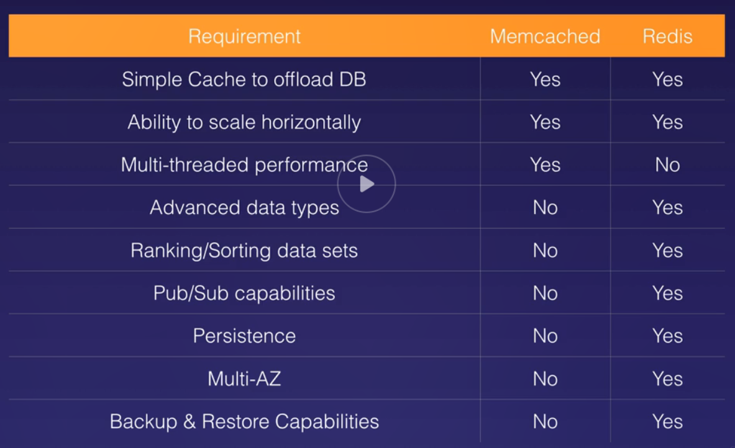
Elasticache
It is a service to assist with web app performance improvement
It comes with 2 options
MemcacheD
Very simple, high-performing option
Lacks some features
REDIS Cache
Offers more features than MemcacheD
Complex objects
Available in multiple AZ
You can do backups and restore
And much more - - -> see pic

Slide 47
AWS – route 53 – a domain name service (DNS 101)
Elastic Load Balancer service (ELBs) do not have pre-defined IPv4 addresses
You resolve to ELBs using a DNS name
Understand the difference between
CNAME
Alias Record
On the exam, when given the choice between a CNAME or an Alias Record, always pick the Alias Record (it’d be nice to know why tho)
Understand Common DNS Types
SOA Records – start of authority record
NS Records – Name Server – indicates which DNS server is authoritative for a domain
A Records – most basic DNS records. Points a domain/sub-domain name to an IPv4 address
CNAMEs – canonical name record
MX Records – electronic mail
PTR Records – allow lookup of dns records given an IP address

Slide 48
AWS – route 53, register a domain name
You can buy domain names from Amazon Route 53
It can take up to 3 days to register and propagate through the internet

Slide 49
Aws – Route 53, routing options
Simple Routing (round robin)
Weighted Routing (%-based routing)
Latency-based Routing (ping-based routing)
Failover Routing (active/passive routing)
Geolocation Routing (region based)
Geo-proximity Routing (Traffic Flow Only)
Multi-value Answer Routing (simple w/ health check)
Resources:
https://docs.aws.amazon.com/Route53/latest/DeveloperGuide/ResourceRecordTypes.html

Slide 50
Aws – Route 53, routing options
Simple Routing
As the name indicates, it is the most basic routing option
You can have a single DNS record with multiple IP addresses associated to it
When a browser hits the DNS record and if multiple IP addresses have been defined, Route 53 will return a random IP address from the list

Slide 51
Aws – Route 53, routing options
Weighted Routing Policy
R53 uses a % with which to split the traffic coming in to a given DNS
The % splits have to add to 100
Helathchecks ( this is for all routing policies)
You can set health checks on individual record sets
If a record fails the health check, it will be removed from R53 until it passes the healthcheck
You can set SNS (simple notification service) alerts to notify you that a Health Check failed

Slide 52
Aws – Route 53, routing options
Latency-based Routing Policy
Route 53 detects the latency for a specific request
It then routes the user to the AWS that is experiencing the least latency from the perspective of the user
If you are in Japan and hit a DNS record and there is low latency to Sydney than to US-West, the traffic will be routed to Sydney

Slide 53
Aws – Route 53, routing options
Fail-over Routing Policy
You need to configure the passive and active IP addresses
You also need to define Health Checks for the EC2 instances behind your IP addresses
Route 53 detects a request to a hosted domain
All requests will go to the Active IP address as long as it has a passing health-check
In case the health-check fails, the R53 will re-route all requests to the passive IP address registered in the routing policy

Slide 54
Aws – Route 53, routing options
Geo-Location Routing Policy
You define which are the geographical locations that a web request should go to
If you define that users in Europe should go to IP address “a” and USA users should go to IP address “b” R53 will forward requests according to settings
Questions:
What happens when users come in from regions not defined?
What happens when one of the regions fails health-checks?

Slide 55
Aws – Route 53, routing options
Geo-Proximity Routing Policy
Lets traffic to your AWS resources based on
Geographic location of your user (lat/lon)
Geographic location of your resources (lat/lon)
You can adjust (increase or decrease) traffic flow based on a bias
To use this feature, you must use R53 Traffic Flow tool

Slide 56
Aws – Route 53, routing options
Multi-Value Answer Routing Policy
This is basically simple routing but for each IP address defined as an independent record
Health-checks need to be enabled for this to work

Slide 57
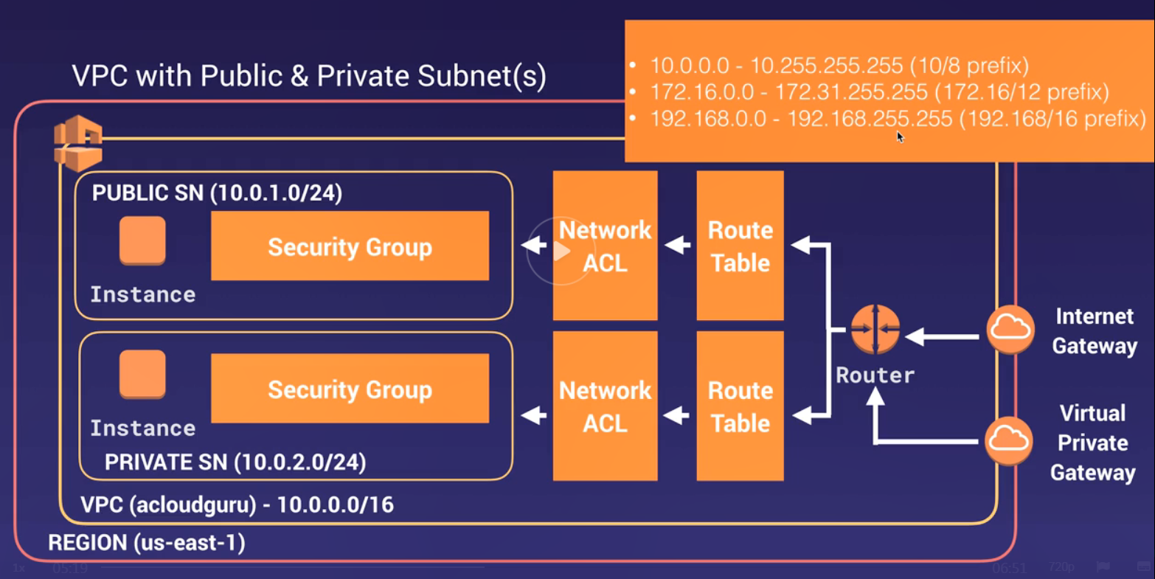
Aws - VPC
Think of a VPC as a logical datacenter in AWS
A VPC consists of
Internet Gateways & Virtual Private Gateways
Route Tables
Network ACLs
Subnets
Security Groups
1 Subnet = 1 AZ, meaning subnets cannot span over multiple Azs
1 AZ can have multiple subnets
Security Groups are Stateful
You can add allow & deny rules
If you define allow or deny, you don’t need to define the return rule
Network ACLs are Stateless
You can add allow & deny rules
Opening in-bound port does not automatically add out-bound traffic. You have to add manually
No transitive peering is allowed
Given: Vpc a < - > Vpc b & vpc b < - > vpc d
Then no traffic can go from vpc a to vpc d unless you define peering between vpc a and vpc d

Slide 59
VPC – Exam Tips
When you create a VPC, the following are created by default
Default Route Table
Network ACL
Default Security Group
When you create a VPC, you have to define
Subnets
Internet Gateway
Remember
For 2 different AWS accounts the same AZ name could refer to different, physical datacenters. The AZs are randomized when assigned.
Amazon always reserves 5 ip addresses within your subnets
x.x.x.0 – network address
x.x.x.1 – reserved for VPC router
x.x.x.2 – reserved for mapping to the AWS-provider DNS
x.x.x.3 – future use (not really disclosed why)
x.x.x.255 – standard broadcast address
You can only have 1 internet gateway per VPC
Security Groups cannot span VPCs

Slide 60
VPC – Nat instances vs nat gateways
Resource: https://docs.aws.amazon.com/vpc/latest/userguide/VPC_NAT_Instance.html
NAT Instance Tips
These are not popular any more
Now we have NAT Gateways
Must provide and EC2 instance be in a Public Subnet and disable source/destination checks of that instance
There must be a route (0.0.0.0/0) from the private subnet to the NAT Instance for it to work
The size/resources of the NAT Instance will dictate its ability to support traffic
If your NAT Instance is bottlenecking, you can increase the instance size
You can create high-availability using Auto Scaling groups, multiple subnets in different AZs and a script to auto-fail-over, but this is very difficult to script and maintain
NAT instances should be within a Security Group (typically a WebDMZ SG)
You are responsible for patching the OS of your NAT Instance
NAT Gawteways Tips
NAT-GW are redundant within an AZ
Preferred enterprise way to access instances in private subnets
Speed rates start at 5 Gb/s and scales up to 45 Gb/s
No need to patch the OS
No need to associate them to a security group
Automatically get assigned an IP address
Remember to update your default VPC route table and attach traffic to your NAT GW
No need to disable source/destination checks
Multiple Azs can share a single NAT GW but this creates a single point of failure concern
If you have resources in private subnets in multiple Azs that need internet access, configure a NAT GW for each of the AZ and update the default rout table to allow 0.0.0.0/0 traffic

Slide 61
VPC – Network ACL vs Security Groups
Traffic Network ACL rules are evaluated before traffic rules in Security Groups
Upon creation of a VPC, a default NACL is created
A default NACL allows all in-bound/out-bound traffic by default
You can create custom NACL
By default, custom NACL denies all in-bound/out-bound traffic until you add specific in-bound/out-bound rules
Each subnet in your VPC must be associated to a NACL
When a subnet is created, it will be assigned to the default NACL. You can change that association later to a custom NACL
To block specific IP addresses use a NACL rule deny access to that IP. You cannot use Security Groups to block IP addresses
A NACL can be associated to multiple subnets, but a subnet can only be associated to 1 NACL at a time
When you associate a subnet to a NACL, the previous NACL association will be removed
A NACL contains a list of allow/deny rules that are ordered sequentially. Starting from the lowest number, the sequence number indicates the order in which the rule will be evaluated by networking HW/SW.
NACLs have separate in-bound/out-bound rules which can either allow or deny traffic
NACLs are stateless. Responses to allowed in-bound traffic are subject to the rules for out-bound traffic (and vice versa)
Note: with Security Groups (which are stateful) that consideration is not need. Allowed in-bound traffic does not require to define the allowed out-bound traffic.

Slide 62
VPC – steps to create vpc with pub/private subnets
Create VPC (10.0.0.0/16 – 65K+ ip addresses)
Default SG
Default NACL
Default RT
Create Internet Gateway
Attach IG to VPC
Create a subnets
Public (10.0.1.0/24 – 256 ip addr)
Private (10.0.2.0/24 – 256 ip addr)
Create custom RT for public-exposed traffic
In bound traffic
Allow ports 22, 80, and 443 (SSH, HTTP, HTTPS)
Out bound traffic
Allow all (0.0.0.0/0)

Slide 63
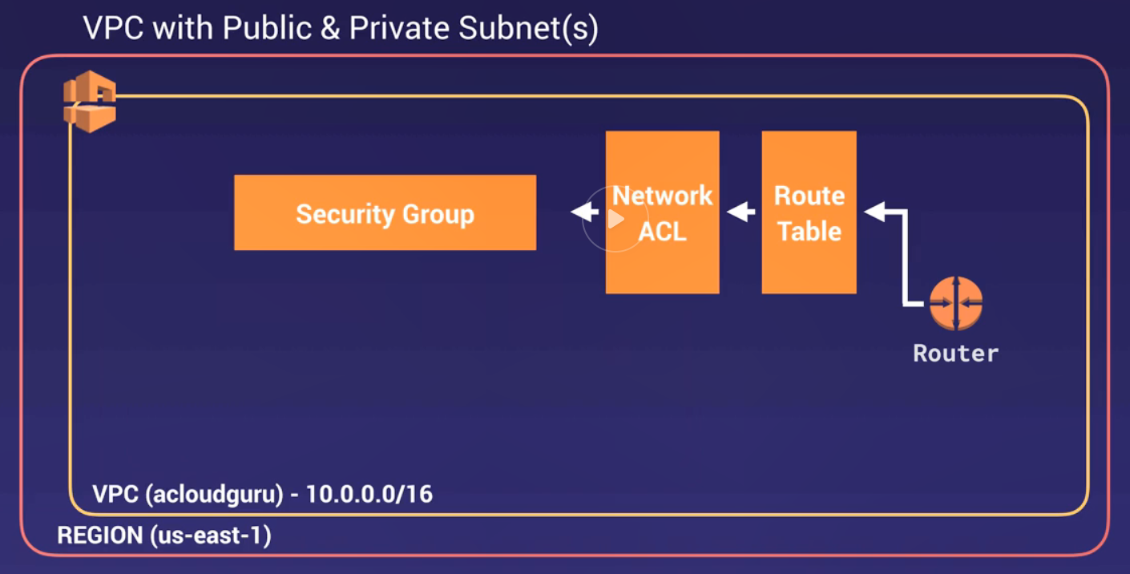
VPC – steps to create vpc with pub/private subnets
Select a Region
Create VPC in that region
CIDR 10.0.0.0/16 for biggest address possible – 65K+ ip addresses
Give a name
By default, the following are created
Default vpc Routing Table
Default vpc NACL
Default vpc Security Group

Slide 64
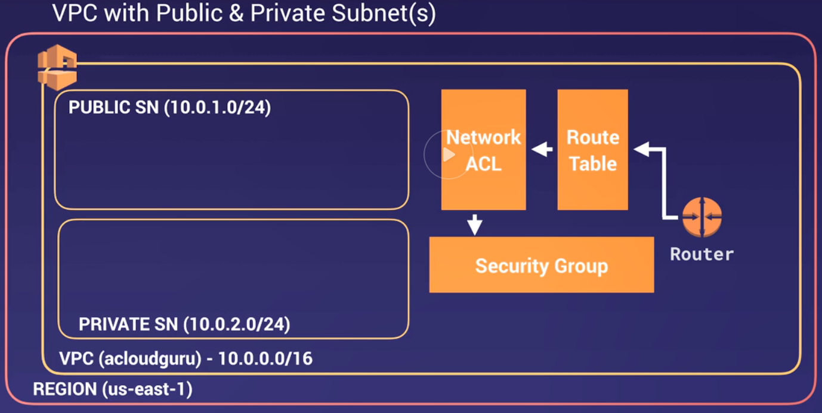
VPC – steps to create vpc with pub/private subnets
Create Public Subnet
CIDR 10.0.1.0/24 – 256 IP addresses
Amazon reserves 5 of those for their use cases
Select AZ for subnet
For name, consider using “<CIDR> – <AZ>”
Set the subnet with auto-assign public IP addresses
Create Private Subnet
Use a different AZ
CIDR 10.0.2.0/24
Associate all subnets to custom VPC

Slide 65
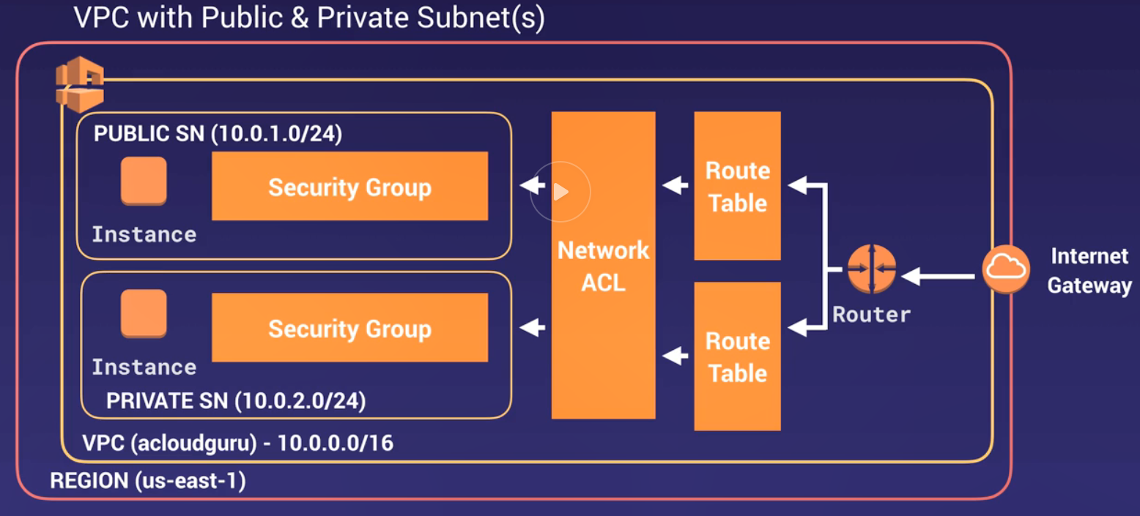
VPC – steps to create vpc with pub/private subnets
Add Internet Gateway and attach it with the VPC
Configure the Main Route table
Always keep it PRIVATE without access to the internet
Create a new Public Route Table and give it access to the internet
Add a route for IPv4 to the Internet Gateway associated to the VPC: 0.0.0.0/0 (all traffic)
If needed add a route for IPv6 (::/0)
Associate the Public subnet to this route table
Provision an EC2 Instance within our Custom VPC with the Public subnet.
Create a WebDMZ Security Group to firewall the publicly exposed EC2 instances
Provision an EC2 instance within Custom VPC with the Private subnet
Use the default Security group for the VPC

Slide 66
VPC – steps to create vpc with pub/private subnets
Create a new security group for your assets deployed in your Private subnet
Give it a Name and Description
Restrict in-bound traffic that only comes from Public subnet
In-bound traffic – allow
Ping – All ICMP
HTTP - 80
HTTPS - 443
SSH - 22
DB – your DB’s port
Change the security group of your private EC2 instances
For private instances you need to provide a safe route out to the Internet. For that you can use
NAT Instances (EC2 instance)
NAT Gateways – a more modern way to provide access to internet resources

Slide 67
VPC flow logs
Flow Logs:
Allow you to capture information about IP traffic going through network interfaces in you custom VPC
Flow Log data is stored in Cloud Watch or in S3 bucket
When using Cloud Watch you can view logs there
Can be created at the level of: VPC > Subnet > network interface (Elastic Network Interface - ENI)
You cannot enable Flow Logs for VPCs that are peered with your VPC unless the peer-VPC is in your account.
You cannot add Tags for a Flow Log (name it wisely)
After you have created a flow log, you cannot change it’s configuration.
For example: you cannot associate a different IAM role for a Flow Log after its creation
Not all IP traffic is monitored
Traffic generated by instances when they contact Amazon’s DNS server. However, if you use your own DNS server, then all traffic to that DNS server is logged.
Traffic generated by a Windows Instance for Amazon Windows license activation
Traffic to/from 169.254.169.254 for instance meta data
DHCP traffic
Traffic to the reserved IP address for the default VPC router

Slide 68
VPC – bastion hosts
Is an EC2 instance that lives in a public sub net in custom VPC to allow remote access to resources in private subnets
A NAT Gateway or NAT instance is used to provide internet traffic to EC2 instances in private subnets
A bastion is used to securely administer EC2 instances, via SSH or RDP (windows machines). Bastions are also known as jump-boxes elsewhere.
You cannot use a NAT gateway as a bastion host

Slide 69
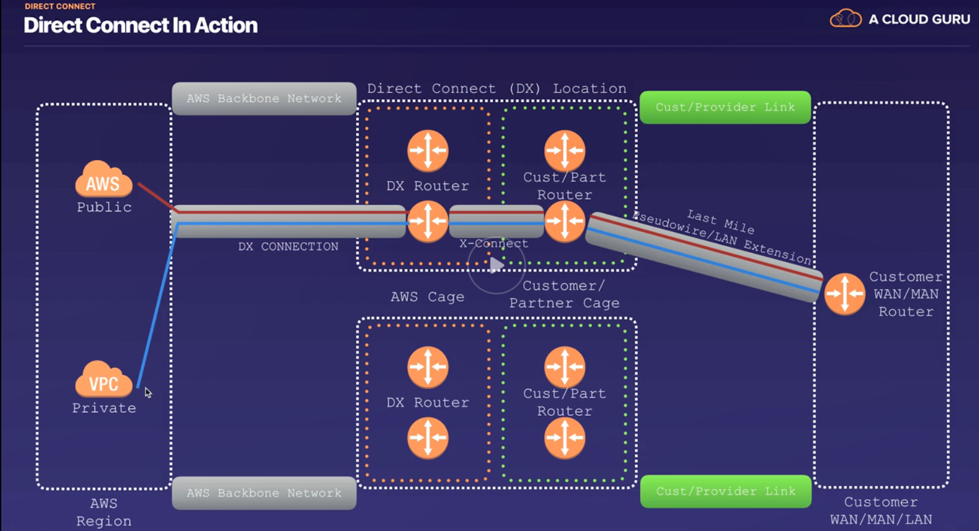
Direct connect
Direct connection from your data center to AWS
Useful for high-throughput workloads (lots of network traffic)
Useful for establishing a stable, reliable, and secure connection to AWS

Slide 70
VPC endpoints
VPC Endpoints are Virtual Devices
Scale horizontally
Are redundant
Highly available
Do not impose
availability risks
Bandwidth constraints on your network traffic
Types of VPC Endpoints
Interface endpoints
Gateway endpoints
Currently GW Endpoints support
Amazon S3
DynamoDB
Enables you to privately connect your VPC to
AWS supported services
VPC endpoint services powered by Private Link
It does not require you to have connectivity via
Internet Gateway
NAT Device / NAT Gateway
VPN connection
AWS Direct Connect
EC2 instances do not require a public IP address
Traffic between your VPC and AWS services do not have to leave the AWS network
Example – you have an EC2 instance that needs to drop objects into an S3 bucket

Slide 71
elastic load balancers (ELBs)
Application Load Balancer (Layer 7)
http/https
Intelligent
Advance / intelligent routing
Network Load Balancer (layer 4)
Tcp traffic balancer
Use if you want
Maximum performance
Fixed IP address
Millions of requests per second
Highest cost
Classic Load Balancer
HTTP/HTTPS
Not app aware
Sticky session (x-forwarded-for header, IPv4)
Lowest cost
Errors
504 errors – Gateway Error on the app at the web server or back-end, DB
Instances monitored by ELBs are reported as
In service
Out of service
Health checks ensure that an instance under ELB is healthy by hitting an HTTP path to that instance
Load Balancers have their own DNS name
You will never get an IP address for a load balancer
SLAs Guarantee (all 3 types of ELBs)
Monthly availability of 99.99%
Read the ELB FAQ:
https://aws.amazon.com/elasticloadbalancing/faqs/

Slide 72
ADVANCED Load balancer theory
Sticky Sessions
Users can stick to the same EC2
Useful when there is application state for given user stored in the EC2
Cross Zone LB
Allows an ELB to forward traffic to a different AZ other than the one it has been defined for
Path Patterns
Allows an ELB to forward traffic to a different AZ based on the URL path coming in the HTTP request

Slide 73
HAA – High availability architecture
Always design for failure
Use multiple AZ in multiple regions whenever you can
Know the difference between
RDS Multi AZ
RDS Read Replicas
Know the difference between
Scaling Out – procuring more similar instances (launching more T2 micro EC2’s)
Scaling Up – Increasing the resources of an instance (from T2 – > XL)
S3 storage classes
HA S3 – Standard S3, Infrequent Access S3
Not HA S3 – Infrequent Access 1 zone or Reduced Redundancy Storage (RRS)
For the exam, read questions carefully and always consider the cost factor

Slide 74
HA – Exam tips
Load balancer types
Application LB
Layer-7 aware. These LBs know more intimate details about the application metadata
With these LB’s you get a DNS / URL – never an IP address
Network LB
Extreme performance at the hardware level (Layer-4 aware)
Can hard-code IP address
Highest cost
Classic LB
Lowest cost
No “intelligent” routing
X-forwarded-for header tells you the IP address of the client calling the app
With these LB’s you get a DNS / URL – never an IP address
ELB Reporting
Errors
504 error code – Gateway timeout
Error is not with the LB. It is probably with the app or the backend (App server or DB)
EC2’s monitored by ELB present either
In-service
Out-of-service
You can track instance’s health with Health Checks (getting a 200 HTTP code after calling GET HTTP verb)
Read ELB FAQs
LB Theory
Sticky Sessions
Allows users to “stick” to the same instance during their session
Cross-zone LB
Enables you to load-balance traffic between Availability Zones
Path Patterns
Enables you to load-balance traffic between different EC2 instances based on URL patterns
CloudFormation
A way to script definition of a cloud environment – lots of granular control: Vpc, subnets, NACL, ec2, etc.
Quickstart Templates – predefined CloudFormation cloud environments targeting specific tech stacks
Targeted to DevOps teams who want full control of their environments
Elastic Beanstalk
Designed to quickly deploy and manage Applications without worrying about infra settings
User deploys the app and EBS takes it from there (similar to Cloud foundry)
Targeted to Developers who do not have/want/need to deal with infrastructure settings

Slide 75
AWS SQS – Simple Queue Service
The first AWS service – has lots of legacy
Messaging / Queuing platform
Decouples components of an application
Messages are stored in a fail-safe queue
SQS is “pull” based not “push” based. A caller needs to access the queue to either add or get messages from the Queue
Messages can only be up to 256 kb of text in any format
Messages can be bigger but it uses S3 to store those – up to 2 gb
Messages can be retrieved programmatically using the SQS API
Auto-scaling can be triggered by number of messages in the Queue
Messages can be kept from 1 min – 14 days – default is 4 days
Msgs are subject to Visibility Timeout – a period of time (12 hours max) that a msg that is accessed by an EC2 is invisible to any other EC2 which is getting messages – this could result in the same message being delivered twice
Long Polling – a request for a message does not return response if Q is empty or Long Poll times out
Short Polling – A request for msg returns immediately even if Q is empty
Standard Queue Type
Is the default type
Nearly unlimited number of TPS
Guarantee that messages are delivered at least once
Provide “Best-Effort” Ordering: Messages are generally delivered in the order they were sent
However, multiple copies of a message may be delivered out of order more than once
FIFO Queue Type
First-in First-out
Up to 300 TPS
Complements the Standard Queue
Order of messages is strictly preserved
Message delivery is guaranteed to be only once and remains available until a consumer deletes it
Duplicates are not introduced into the Queue

Slide 76
AWS Simple workflow service (SWF)
Know the difference between SWF vs SQS
Retention
SQS has a retention period of 14 days
SWF – workflow executions can persist for up to 1 year
Orientation of Use Case
SQS – offers a “Message-Oriented” API solution
SWF – Offers a “Task-Oriented” API solution
Duplication
SQS – has flexibility of handling duplicated messages or enforcing FIFO
SWF – ensures that tasks are assigned only once and are never duplicated
Tracking
SQS – your application needs to implement app-level tracking of messages
SWF – Keeps track of all tasks and events in an application
Actors (applies only to SWF)
Workflow Starters – applications that can initiate an SWF workflow
Deciders – decide what to do next after a task finishes in a workflow, handle error state
Activity Workers – Carry out logic work within a step in the workflow

Slide 77
AWS – simple notification service (SNS)
Service that allows setting up, operate and send messages from the cloud
Usable for Push Notifications for mobile applications
Able to deliver messages by SQS, SMS Text or Email
Uses Topics to associate publishers and subscribers for message distribution
Messages published to SNS are stored redundantly across multiple Azs
Benefits
Instantaneous push-based delivery
Simple API and simple integration with Apps
Flexible message delivery over multiple transport protocols
Inexpensive, pay-as-you-go model. No upfront costs
AWS console offers simple UI to manage
SNS vs SQS
Both are messaging systems
SNS is push-based. SQS is pull-based

Slide 78
AWS – elastic transcoder
Is a could-based, media transcoder
Converts media files from their original source format into different formats that will play on different devices (tablets, smart phones, PCs, etc)

Slide 79
AWS – API gateway
API GW – is a “door” from the internet to your AWS environment (different than internet gw to EC2 instances)
It has caching capabilities to increase performance (need to set a TTL in seconds)
It has a low cost
Scales automatically
It can be throttled to prevent attacks
Results can be logged to CloudWatch
If your application uses multiple domains with API GW, ensure that CORS is enabled
Remember that CORS is enforced by your browser to reduce vulnerabilities and injection attacks of malicious code

Slide 80
Aws – kinesis
It is an AWS service/platform for processing data streams
Comes in 3 types: streams, Firehose, Analytics
K-Streams
Data producers can send data to Kinesis
Data has persistence and is stored 24 hours (default) up to 7 days
Data is stored in “shards” which are logical groupings that Data Consumers (EC2) instances can access, process and store the results of the work
Performance of Shards
5 tps for read rate up to 2 mb maximum read rate per second
1000 tps for writes up to 1 mb maximum write rate per second (including partition keys)
Data capacity for a stream depends on the number of shards that are provisioned for it
K-Firehose
Data is not persisted. It has to be processed as it is received
Lambda functions are good processors of in-coming data
K-Analytics
Works with k-streams or k-firehose and analyzes the data on the fly
After analysis, it sores the data in S3, Redshift or Elasticsearch Cluster

Slide 81
IAM – cognito
AWS allows you to leverage Web Identity Federation services (i.e. google id, facebook id, amazon id, etc) to provide temporary access to AWS services for authenticated users via Amazon Cognito
Allows sign-up and sign-in to apps
If not using federated IDs, then the app can use Cognito user pool
Allows access for “guest” users
Acts as an ID broker between web-id providers and AWS
Successful Authentication results in the creation of JWT to grant access to services
Synchronizes user data for multiple devices
Recommended for all mobile applications that access AWS services
Identity pools
These deal with authorization of users
Provide temporary access to AWS resources

Slide 82
AWS – Lambda Functions
Lambda scales out (not up) automatically
Lambda functions are independent, 1 event = 1 function
Lambda is server-less. Understand what AWS services are server-less:
Aurora DB
DynamoDB
API Gateway
S3
Lambda
Lambda functions can trigger other Lambda functions
Draw-backs/Trade offs
Solutions can get really complex with lambda
Networks of lambda functions can be difficult to debug
Use AWS X-Ray service to debug server-less applications
Lambda functions can help you trigger actions globally across AWS’ global infrastructure (i.e. Back-up an S3 bucket to another one)
Understand what are the different Triggers for Lambda functions

Slide 83
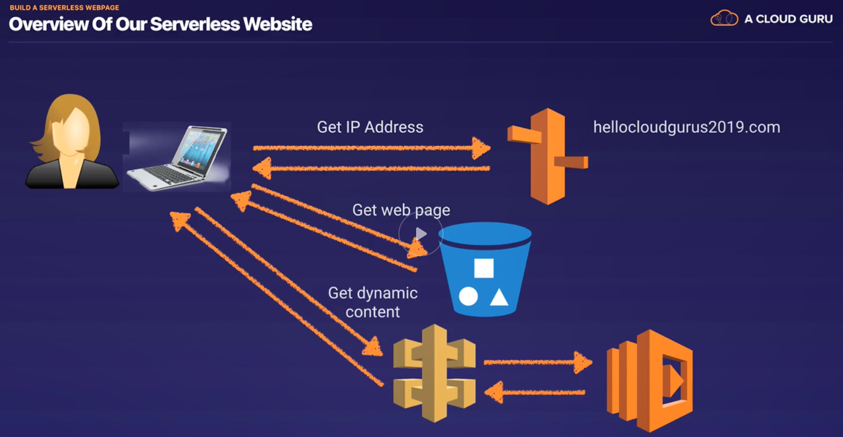
Lambda serverless web page example

Slide 84
Server-less summary
Remember the difference between
Traditional architecture
Manual construction or automatic (via AWS Cloudformation or AWS Elastic Beanstalk)
Has limitations for scalability
Could be costly as you scale out
Server-less architecture
Highly scalable
Highly available
Lowest cost
Lambda Function Benefits
Scale out not up
Are independent… 1 event = 1 function
Functions are serverless
Know what services trigger (or not) Lambda functions
Lambda Functions can trigger other functions
Can do things globally within the AWS infrastructure and services (i.e. use it to back up S3 buckets)
Lambda Function drawbacks/tradeoffs
Architectures can get really complex and hard to debug (Mitigation: AWS X-Ray service)

